Slide 1
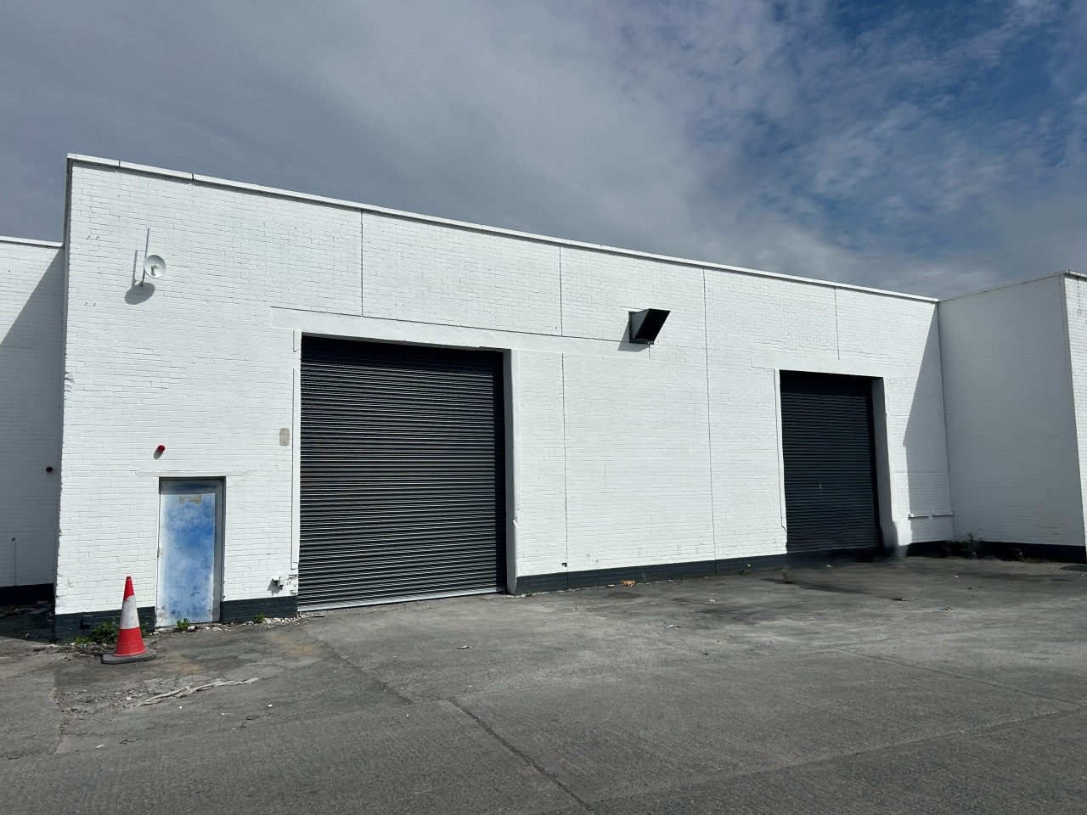
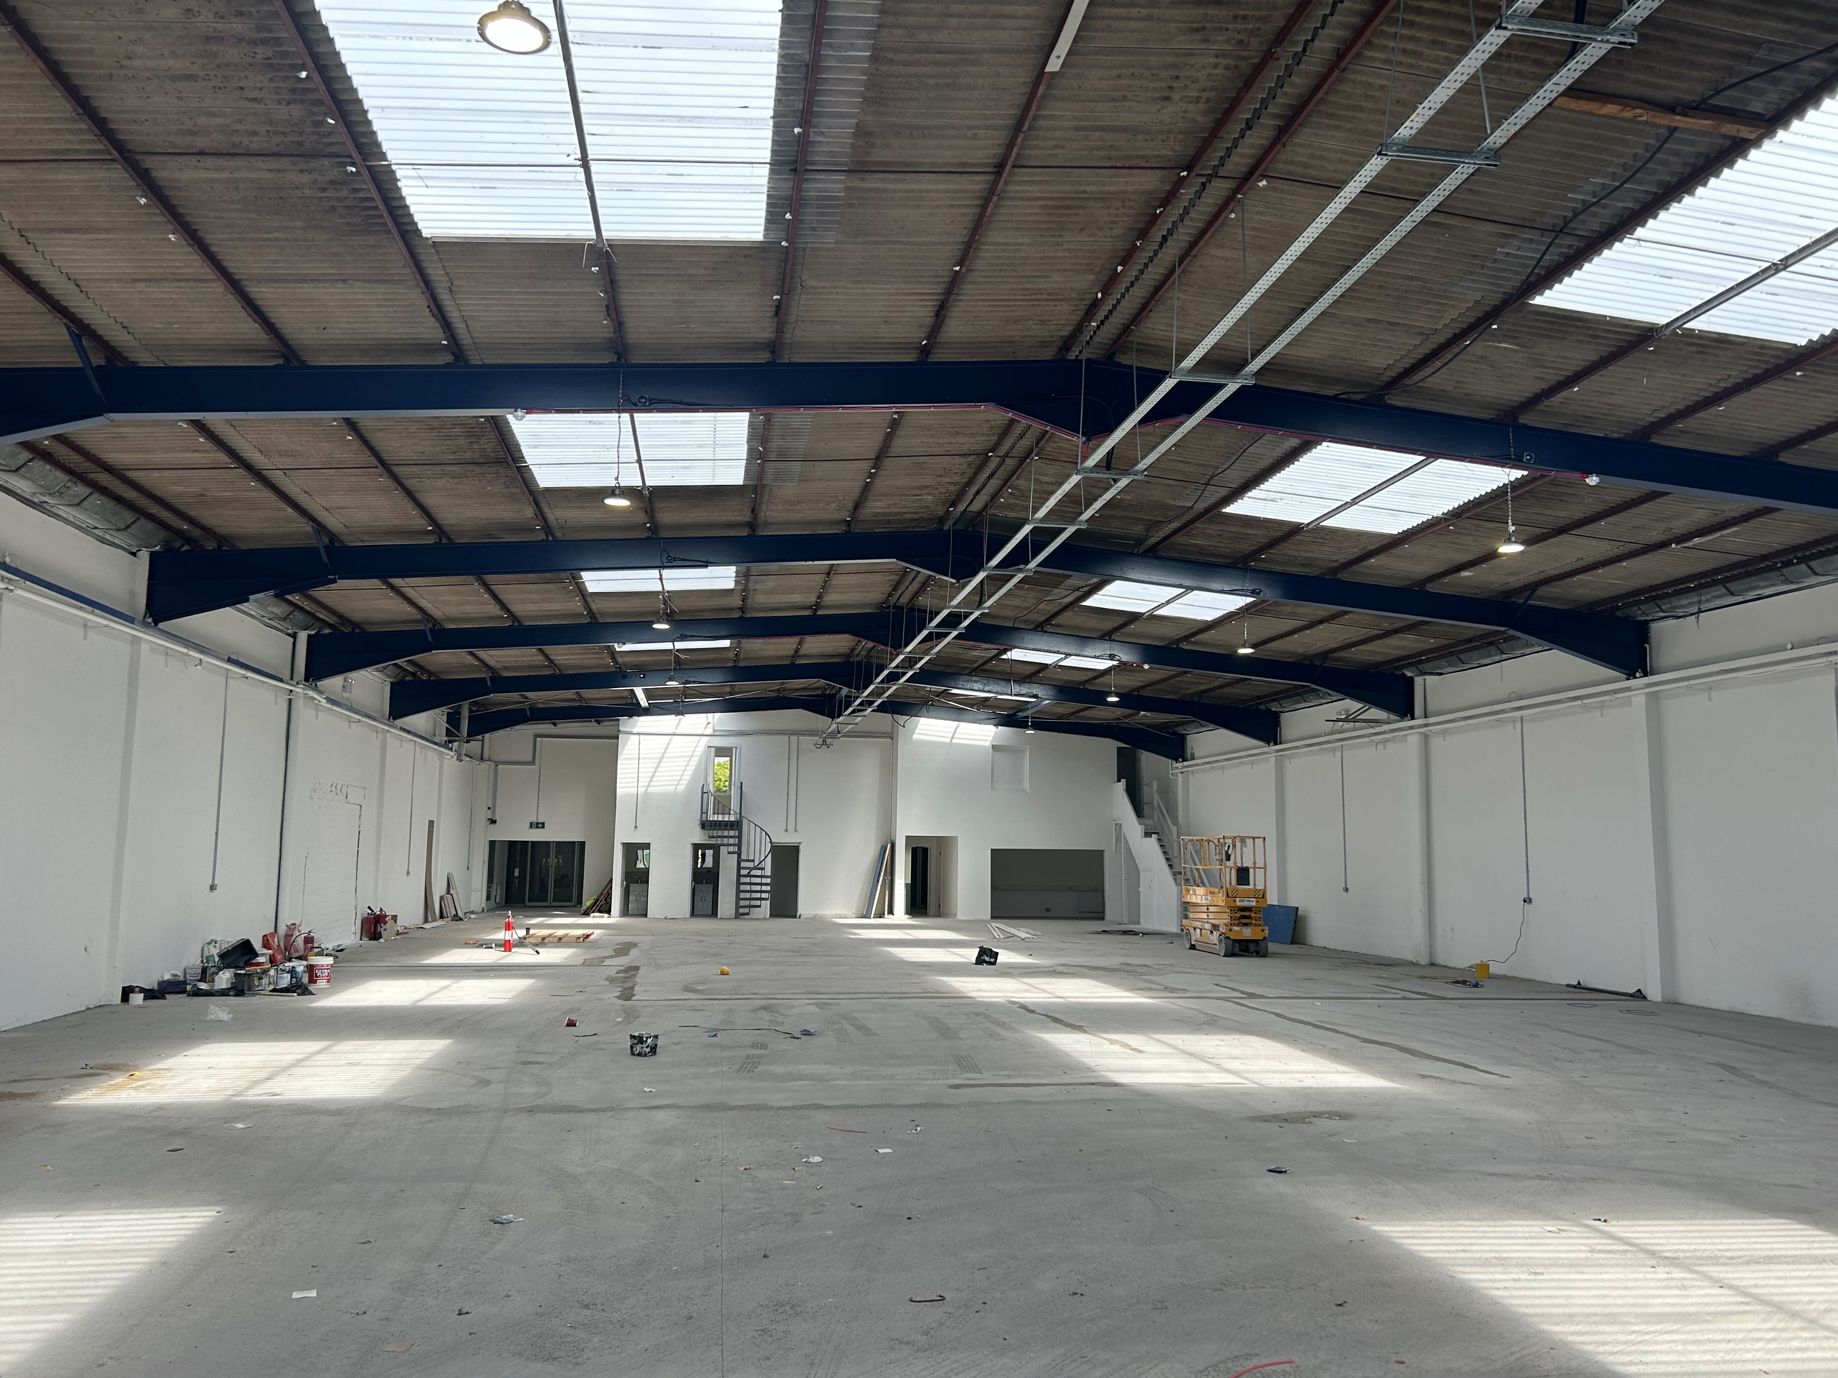
TO LET
Unit 2B, Avonbeg Industrial Estate, Dublin 12
Terraced
Property Highlights
Contact
Terraced Industrial Building that extends to 1,075 sq m / 11,571 sq ft with 264sq m / 2,844 sq ft of office space.
Recently undergone extensive refurbishment works.
The property is situated within Avonbeg Industrial Estate, located on the northern side of the Longmile Road and close to its junction with Naas Road.
Excellent profile from the Naas Road.
Set within an industrial location, the property offers opportunities for a mix of commercial uses such as leisure, retail wholesale and industrial (S.P.P).
Loading access is via a single roller shutter door.
Nicola Gilleece
Email: Nicola.gilleece@cushwake.com
Tel: +353 1 639 9384
Marc Kelly
Email: marc.kelly@cushwake.com
Tel: +353 1 639 9258
Cushman & Wakefield
164 Shelbourne Road
Ballsbridge, Dublin 4
Ireland
Tel: +353 (0)1 639 9300
cushmanwakefield.ie

Slide 2
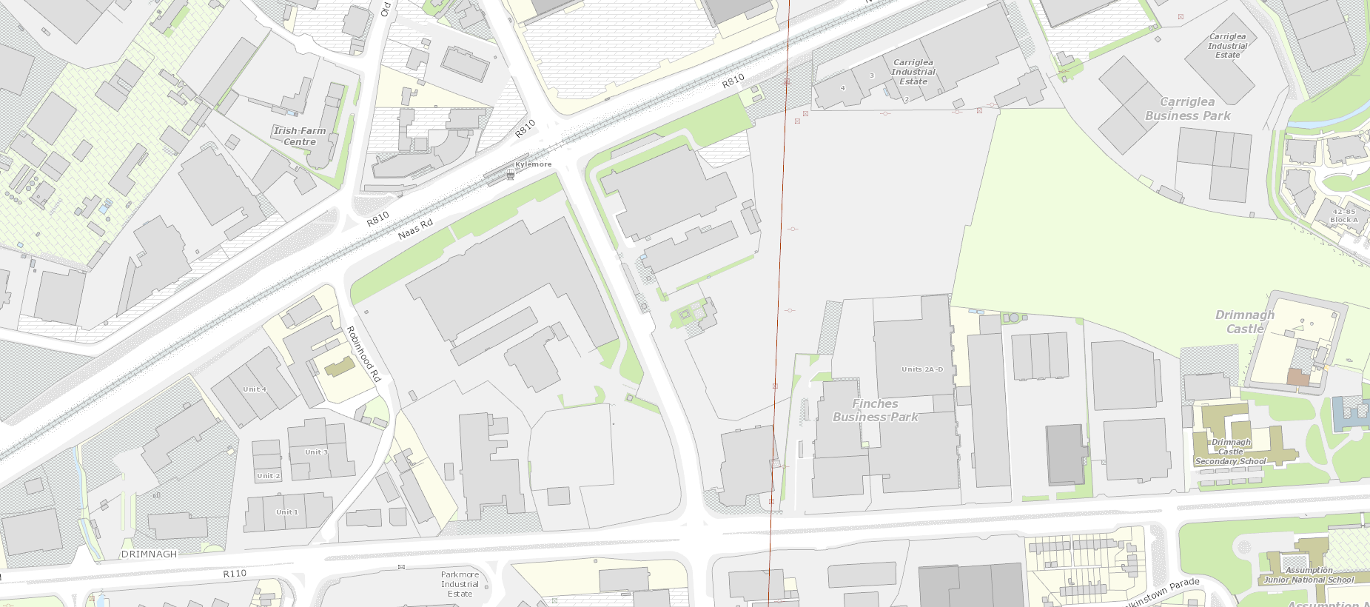
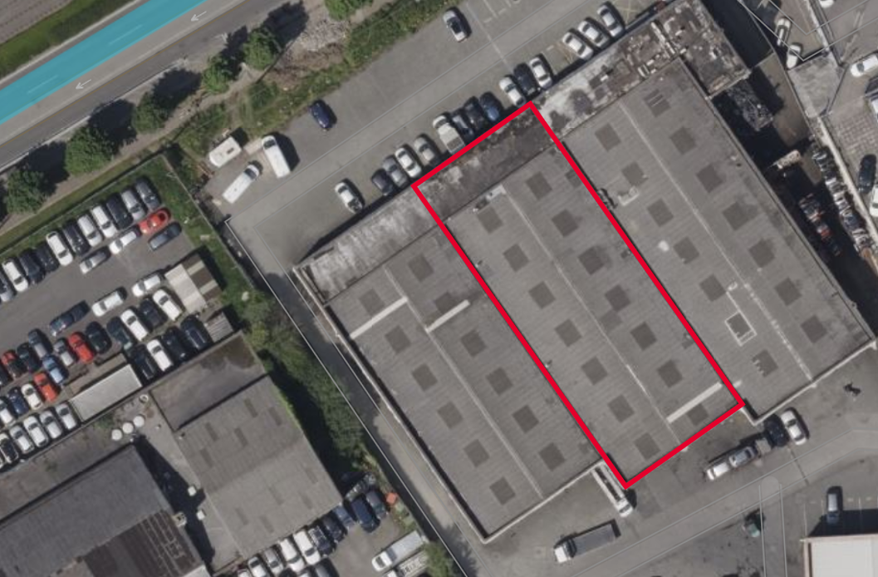
Location
Has undergone extensive refurbishment works
Clear internal height of approx. 4.0 m
Loading access is via a single loading door.
This property is located approximately 7 km southwest of Dublin city centre. The site benefits from excellent transport links, with the M50 motorway and N7 road in close proximity, providing easy access to national routes. Public transport options include nearby bus routes 27, 56A, and 77A, as well as the Kylemore Luas stop on the Red Line, enhancing connectivity.
Surrounding areas feature a mix of industrial and commercial uses, with prominent neighboring occupiers such as AXA Insurance, Renault Trucks, Hyundai, DHL. The estate is surrounded by other industrial sites including the Western Industrial Estate and Park West Business Park. The area is well-serviced with amenities, ensuring a convenient and strategic location for businesses requiring both accessibility and robust infrastructure.
Accommodation Schedule
Description | Size (Sq m) | Size (Sq ft)
Warehouse | 811 | 8,727
Office | 264 | 2,844
Total | 1,075 | 11,571
Rent
€130,000 (exclusive of VAT)
Commercial Rates
€15,456
Service Charge / Insurance
Description
TBC
The subject property consists of a warehouse unit of steel frame construction with translucent panels and LED roof lighting
There is two office spaces on the northern end of the building comprising of 74.4 sqm and 57.7 sqm respectively.
Viewings
View by appointment with sole agents Cushman & Wakefield
BER Details
BER No. 800986960
BER Indicator. 481.05 kWh/m2/yr
Former Concorde Motor Showrooms
Naas Road
Maxol Filling Station
Long Mile Road
Conditions to be noted: A full copy of our general brochure conditions can be viewed on our website at https://property.cushmanwakefield.ie/disclaimer or can be requested from your local Cushman & Wakefield office. We strongly recommend that you familiarise yourself with these general conditions. PSRA Registration Number: 002222.

